Slide 1
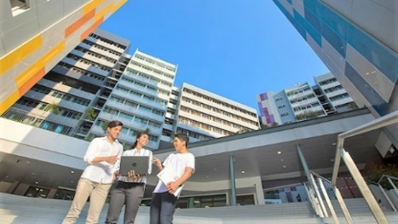
Student Experience Survey
Your voice counts.
Tell us how NTU can enrich your university experience.
2016
For NTU/NIE students for at least one semester, please check your email (inbox/spam/junk folder) for the survey invitation and link using PC or portable devices:
Your feedback is valuable in improving areas such as Academic/Research Programme, Learning & Teaching, Assessment & Feedback, Student Services, Campus Life, etc.
150 Lucky Draw prizes to be won!
New lifestyle hub at
North Spine
From : NTU Student Experience Survey 2019
<ntusurveyadmin@beacon.com.sg>
Search keyword ‘ntusurveyadmin’ or ‘beacon’
2017
1,800 more hall places, and guaranteed 2 years hall stay for freshmen
2018
… and more
The Arc
Learning Hub North
If you have any query, please contact NTUStudentSurvey@ntu.edu.sg

